Slide 1
Personalities and motivation
and their role in managing players in esports
Daniel Casley

Slide 2
tIMELINE
Before beginning, let’s establish what we’re going to be discussing today:
Theories of Player Personality
Theories of Player Motivation
Trait theory
Interactional approach
Herzberg’s theory of motivation
Need Achievement Theory
We will be discussing what these theories mean, and how they can be useful in aiding players in performing at their best level.

Slide 3
Introduction
eSports is a very difficult sector for players to get into. With confusing paths and high competition it can be hard for people to find their way into the craze inspiring hundreds of millions of people around the world.
Even upon finding their way in, players are subjected to 12 hour work days full of stress, anger and frustration at themselves or maybe others, leading to conflicts, inevitable early burnouts and retirement.
As a managerial role, it is our responsibility to ensure that players both play at their best and communicate at their best with their teammates at all times. That is why I believe it is imperative that everyone – including our players – become more mindful about psychological methods of deterring these complications.

Slide 4
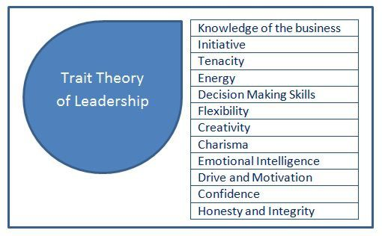
Trait theory
Trait theory suggests that somebody is born with an unchangeable set of characteristics which define how they react to certain things happening around them.
For example, one player may see a loss as a learning opportunity, whereas another may see it as an embarrassment.
As another example, one of your players may perhaps have a great leadership role over the team. This may incline you to put them in a shot calling role.

Slide 5
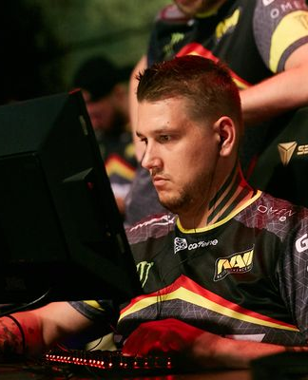
CASE STUDY: ZEUS from GAMBIT ESPORTS
(Counter Strike: Global Offensive)
One great example of this leadership mindset is Zeus from the Counter Strike: Global Offensive scene. Zeus was not mechanically an incredibly gifted player, known affectionately as “CS:GO’s Brain-dead Mastermind”, however his shot-calling managed to lead his team - Natus Vincere - to finals many, many times over.
He then left his original team after an unfortunate controversy to pilot his own team, where he fulfilled a coaching role for up and coming young “nobody” players.
His team pulled off an unbelievable streak of wins, becoming one of the top teams in CS:GO in the span of a single tournament, with many of the players having never even been seen in a competitive scenario before.
That team is now known as Gambit eSports, an international entity in eSports and one of the top teams in Valorant.
Information gathered from: TheScore eSports

Slide 6
Why is this way of thinking dangerous?
One problem with this way of thinking is that it implies that players cannot change their traits. This is a problem, as throwing out players with minor inconvenient traits but undeniable skills in the game is a waste of talent and would rather be avoided.
Therefore, simply submitting to the idea that their traits cannot be changed could be inefficient if you're trying to build up team synergy.
So, along comes the interactional method of explaining personality types.

Slide 7

Interactional method
The interactional method suggests that someone's personality type merely influences their reaction to the environment.

Slide 8

Visualisation
For convenience, you can imagine the interactional way of looking at personality types as a tipping scale. Your "personality" could be represented as a weight in that scale, making it tip easier to one side than the other.

Slide 9
CASE STUDY: BWIPO FROM FNATIC
(League of Legends)
One example of the interactional method being shown in eSports is simply by observing a player's adaptability.
Before May of 2021, League of Legends player Bwipo was originally a top laner – a role which requires aggression and good isolated play - however in order to adapt to his team's demands he switched to jungle, which requires exceptional macro play and forethought.
Trait theory would imply that he cannot change his ways, however he ended up training to a professional level in jungle and his team came second in the LEC 2021 split.
Even further: Bwipo has professionally made three separate role swaps throughout his career – from a patient role, to an aggressive role and most recently into a mindful role – and performed at a ludicrously high level in each, regardless of how different each of them are.

Slide 10
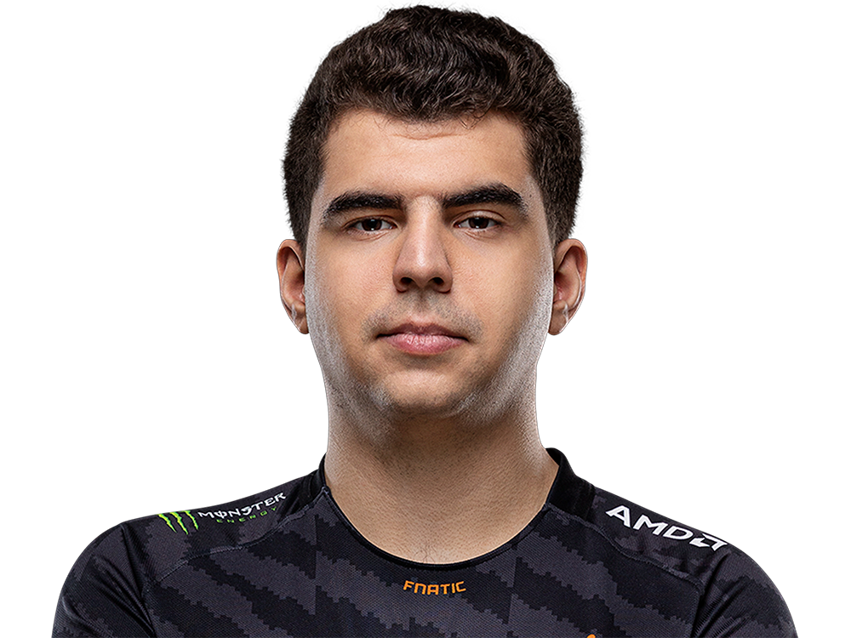
However, this isn’t to say every role in the game is completely different. Each role shares transferrable skills that will help learn other roles – such as general awareness of the game, champion mechanics and last-hitting/camp farming.
Therefore, we cannot definitively say that the changes in role are giant to the point where his traits could not cross over – for example, you could technically be aggressive in all three roles.
As a counterpoint, however, most League of Legends players stick to maybe one or two roles, especially in pro play. This is because regardless of transferrable skills, swapping roles is extremely difficult and can even hamper progress overall if you swap too often. Therefore, it is undeniable it took hard work for Bwipo to “tip” those scales.

Slide 11
TIPPING THE SCALES
By imagining personality in this way, we can begin to think about ways to "tip the scales". The question arises, however – how DO we tip those scales in the right direction?
One way we can begin to tip the scales in our favor is by motivating players through various means. By motivating the players, they may be more inclined to put in the effort to change their habits, if needed.
The idea of “motivating” may seem obvious, however there are different types of motivation that we can learn to understand and apply.
One such theory that is important to understand is Herzberg's theory of motivation.

Slide 12
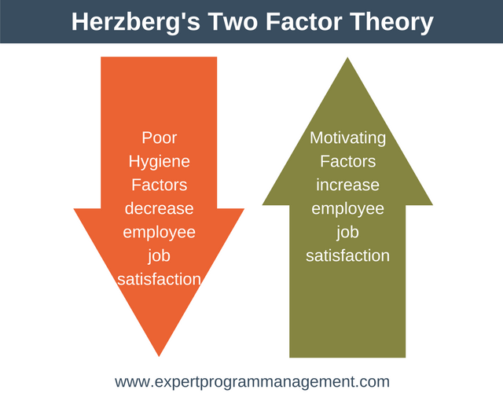
Herzberg's theory of motivation
One thing that is important to understand about motivation is how different kinds of motivation will affect players. Herzberg argues that there is a distinction to make between the two, and that there needs to be a balance to create optimal conditions.

Slide 13
balance
Herzberg states that there are two kinds of motivation – motivation factors and hygiene factors.
Having great motivation factors will encourage a player to work harder than they would without them – however, if the hygiene factors are poor, they will be less satisfied with their position which will decrease their motivation to work harder.
Therefore, it is important to make sure that players are enjoying their time while also having the motivational factors to strive for greater things.

Slide 14
examples
Motivational factors could be things such as:
Achievement
Recognition
Responsibility
While hygiene factors could be things such as:
Working conditions
Salary
Relationships

Slide 15
Hygiene factors
Hygiene factor is incredibly important to get right, as it is one of the main reasons why pro players burn out so quickly – as their work days become more stressful, players begin to want to leave.
Hygiene factors are environmental factors that affect an employee’s satisfaction with a position. For example, the working conditions or the employee’s salary.
One way we could meet hygiene factor criteria in eSports is by providing players with a team they can synergise well with.
By having a convenient and enjoyable work environment, players will be able to enjoy their time practicing more and will have more motivation to work. With 12 hour work days especially, enjoying your time is important.

Slide 16
Motivation factors
Motivation factors are individual factors that affect an employee’s satisfaction with their position. For example, the amount of recognition they get for doing their job or the responsibility they feel for doing it.
One way we could meet motivation factors is by giving players responsibility. One way we can do this is by creating a competitive nature in the workplace.
For example, if you are trying to get a player to switch roles, you could present them with a player who is better than them at that role, and try to spark a friendly rivalry between the two. By having an incentive to get better, this player will push harder to make sure he reaches the same level as the other player.
However, one issue with this is that competitivity can cause toxicity between others, worsening the relationships between them. Therefore, it is important to make sure all competitivity is done in moderation.

Slide 17

Harmful mindsets
As a counterpoint, however, competitivity is generally fine, depending on the person. Some people simply don’t like the challenge of being compared to others. Some people will become toxic and, rather than try to achieve their own goals, will focus entirely on trying to avoid failure.
There is a theory that explores these kinds of mindsets and how harmful they can be: the Need Achievement theory.

Slide 18

Need ACHIEVEMENT THEORY
In a competitive environment such as ours, it is extremely important to find ways to avoid harmful mindsets creeping up on players.
Understanding these mindsets and common “red flags” is imperative to making sure players do not find their progress hampered by their mindset.
Despite its bland name, this important theory states that players in competitive scenarios struggle with two different types of motivation mindset – the need to achieve, and the need to merely avoid failure.

Slide 19
N-ACH AND N-AF
The need to achieve (known as NACH) is where players strive to achieve their own goals – who set their sights on something and aim to achieve that thing, rather than worrying about the bumpy road towards it.
On the contrary, the need to avoid failure (also known as NAF) is when players focus more on the avoidance of mistakes rather than embracing them as a path to success.
The latter is an important mindset to avoid, for the following reasons…

Slide 20
N-AF
…studies show that those who simply try to avoid failure in competition are slower workers, tend to avoid challenge out of the fear of failure and do not like being assessed due to the possibility of failing assessment.
The avoidance of challenge and the dislike of being assessed are awful traits to have in a player as challenge and assessment are main parts of competing as a player. Therefore, it is not surprising to know that most athletes tend to fall into the N-ACH category.
If the player in the earlier example were to have a N-AF mindset, he may try to avoid confrontation with the better player rather than see it as a learning opportunity.

Slide 21
N-ACH
On the contrary, those who strive to achieve in competition show determination, love for challenge, and tend to be quicker workers.
These traits are extremely useful to have in a player as the player’s motivation and genuine interest in the sector will facilitate a greater rate of learning.
In addition, they will be more enjoyable to work with as they will have a more positive outlook and even may last longer in the profession and burn out later.
It’s no surprise, in this case, that most athletes fall into the N-ACH category.

Slide 22
N-ACH
However, one problem to consider is that those with the N-ACH mindset are very high maintenance.
Players with a N-ACH mindset require lots of praise and attention for their achievements, or they may become dissatisfied with their position and have a weaker work ethic as a result.
This directly ties into Herzberg’s theory – players with this N-ACH mindset require greater and more frequent motivation factors to perform at their best – they require a balance. Those with a N-AF mindset, however, may be easier to manage as they are more independently motivated and don’t require constant external motivation.
For a smaller organisation who don’t have as much money and/or time to spend on their players, N-AF players may even be preferable - but only in those extreme circumstances.

Slide 23

NEED ACHIEVEMENT THEORY
An issue with the Need Achievement theory is that it is extremely difficult to recognise who has high or low N-ACH tendencies.
If a player is taking challenging tasks, you could say that person has high N-ACH tendencies as they are taking challenging tasks regardless of the possibility of failure. However, you could also say that they are trying to avoid confrontation under the guise of “it’s a hard task, so I can’t be blamed for failing, right?”.

Slide 24
NEED ACHIEVEMENT THEORY
The Need Achievement theory struggles with walking a grey line where subjectivity can affect the results.
Your negative opinion of a person could sway you to think they’re “trying to avoid blame”, whereas if you had a positive opinion of that person it could sway you to think they’re “pushing for greater”.
Therefore, it’s not always the easiest thing to put into practice and should not be used as evidence.
However, the fundamentals of the theory are still important to understand as knowledge of it can help to simplify the inner workings of a player and can also help to avoid those mindsets. The theory does not necessarily have to be quantifiable to be useful.

Slide 25
How to use personality and motivation to develop a highly motivational and productive environment
The question still stands – how can we use these to improve player performance?

Slide 26
Personality
Firstly, when attempting to build a good work environment for your players, you should first consider what they’re good at. Do they prefer shotcalling? Are they good at mechanical plays or at a certain lane?
Then, consider whether it is worth it to put the effort to tip those scales. Think in terms of what the team needs. Would it be cost efficient to push them to other things? Do you need to?

Slide 27

Motivation
If this is the case or regardless, you need to motivate them to change their ways/improve. You can do this by improving relationships in the workplace, providing hygiene factors and motivation for the players such as family/friends’ encouragement. It’s quite simple – by treating players better, they’ll feel more comfortable working with you and their teammates and will feel better about pushing themselves harder.
Finally, observe what kind of mindset they have and try to guide them to a better one. Try to encourage the players to think in terms of achievements rather than failures in order to develop the greatest learning mindset.
This is the best way to ensure your players will be happy and hard working.

Slide 28

FIN
Thank you for listening!

